Slide 1
AI-Powered Riverbank Erosion Risk Prediction and Early Warning System for Bangladesh
Course code : SE-331 | Section : 41 E1
Hasib ur Rahman (232-35-590)
Dhroubo Jyoti Mondal (232-35-182)
Masoud Ibna Mostofa (232-35-551)

Slide 2
Riverbank erosion: a silent, recurring disaster
50k–200k
≈ 1 million
5–10k ha
386+ houses
people displaced by bank erosion each year (Univ. of Dhaka / Sussex, 2013)
people affected by riverbank erosion every year (IFRC, 2001)
land lost to rivers per year; estimates vary by source
washed away along the Teesta in one week, Sept 2026
Officials call it a “silent cancer”: it can hurt more than floods or storms because collapse takes minutes and families lose land and belongings together. Protection such as geo-bags is mostly reactive.

Slide 3
Where the land goes: the Jamuna dominates
≈ 59%
of total eroded land is Jamuna’s (94,220 of 158,353 ha)
14,955 ha
regained by the Jamuna; net loss still ≈ 79,000 ha
~1,000
people displaced for every km² lost (researcher estimate)

Slide 4
No single number: annual land-loss estimates differ ~10×
Why this matters
No agency keeps a systematic record of erosion losses, so figures disagree.
Jamuna’s rate fell from ~5,000 ha/yr (1980s) to ~1,500, yet villages still lose homes in minutes.
Regional averages cannot warn one village bank: it needs its own sensor stream.

Slide 5
Current practice: valuable, but regional or reactive
(a) Water-level gauge stations
(b) Manual field inspection
Gives: Regional river level
Limit: Does not describe bank condition at a village
Gives: Local observation by people
Limit: Cannot watch every bank continuously; subjective
(c) Historical records and maps
(d) Satellite imagery and GIS
Gives: Where erosion happened before
Limit: Describes the past, not the next hours
Gives: Bank-line change over time
Limit: Delays of days or weeks; cannot warn within hours
The gap: no tool gives a small community a localized, automatic, forward-looking signal. ML exists for floods and remote sensing, but needs big data and rarely reaches one village bank.

Slide 6
Problem statement and why AI is needed
Four limitations today
Continuous watching of every vulnerable location is not possible manually
Combining several indicators by eye is subjective and experience-dependent
Existing systems describe the present and do not estimate erosion chance in coming hours
Warnings reach communities late, or not at all
Today: human expert
Compares water level, rainfall and bank condition with memory of past events.
With AI: supervised ML model
Learns indicator-to-erosion relationships from data and scores every new reading as a probability for the next time window.
Affected: families, farmers, landowners, local authorities. Scope: risk prediction only, not exact location or land loss.

Slide 7
Objectives and scope
In scope
Out of scope
ESP32 sensing: water level, rainfall, soil moisture, tilt, vibration, temp, humidity
Wi-Fi transfer, server and database
Preprocessing and feature engineering
ML risk prediction: Low / Medium / High / Critical
Web dashboard and LED + buzzer alert
Model comparison and feature importance
Whole-river or multi-site deployment (one station only)
Building bank protection or controlling flow
Exact erosion location or land-loss amount
Replacing official authorities
Mobile app, SMS, satellite deep learning
General: low-cost IoT + AI prototype that monitors bank conditions and warns of rising risk.
AI: train and compare supervised models that output erosion probability for a future window.

Slide 8
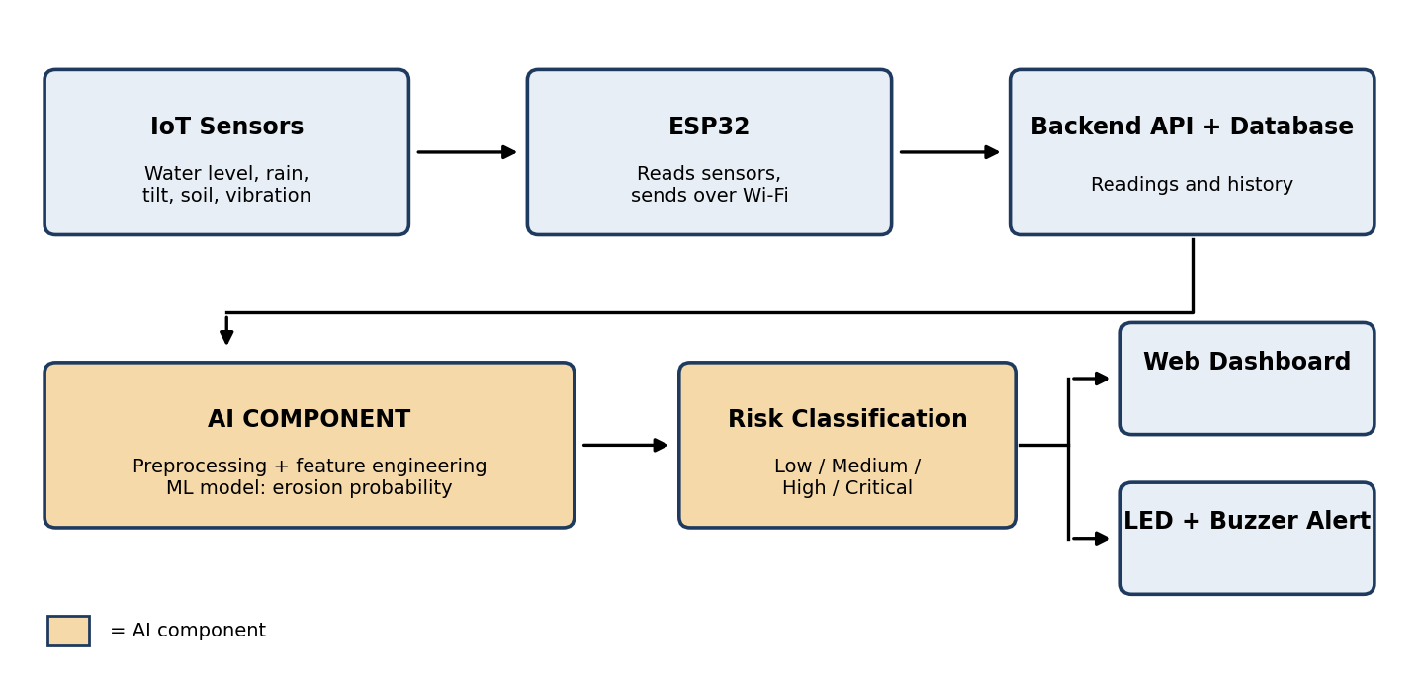
Proposed solution: end-to-end pipeline

Slide 9
Layered system architecture
1 Sensing
Sensors + ESP32 read conditions every few minutes
2 Communication
Wi-Fi + REST API (FastAPI), API-key protected
3 Data
MySQL: readings, history, station data
4 Intelligence (AI)
Cleaning, features (water-level change, accumulated rainfall), ML model, risk level
5 Presentation
Web dashboard (live, trends, map) + LED/buzzer alert unit

Slide 10
Hardware sensing node and technology stack
ESP32
JSN-SR04T
Rain sensor / tipping bucket
Soil-moisture sensor
Wi-Fi microcontroller
Waterproof ultrasonic: water level
Rainfall
Soil moisture
MPU6050
DHT22
LEDs + buzzer
Power bank + enclosure
Bank tilt and vibration
Temperature and humidity
Local risk alert
Field power and housing
Software stack
Python • C/C++ (Arduino) • FastAPI • MySQL • Pandas, NumPy, Scikit-learn, XGBoost • Chart.js • OpenStreetMap • Git/GitHub. Own models only; no external LLM API.

Slide 11
AI approach: from sensor data to risk level
1 Data
2 Features
3 Train
4 Evaluate
5 Predict
Historical labeled records + sensor readings
Water-level change, accumulated rainfall, soil moisture, tilt
4 models, chronological split
Accuracy, Precision, Recall, F1, ROC-AUC
Probability to risk level
Candidate models (compared on a time-ordered test set)
Logistic Regression (baseline)
Random Forest
XGBoost
SVM
Risk levels (thresholds chosen on validation data)
Low
Medium
High
Critical
LED + buzzer trigger at High/Critical only when it persists over consecutive predictions.

Slide 12
Requirements at a glance:
Sensor Data Collection: Read water level, rainfall, soil moisture, tilt, vibration, temp, and humidity via ESP32.
Data Transmission: Send readings to server over Wi-Fi with timestamps.
Storage & Cleanup: Store readings in a database and handle invalid/missing data.
Feature Engineering: Calculate water level changes and accumulated rainfall.
Web Dashboard: Display live readings, historical trends, and station status.
Hardware Alert: Trigger LEDs and a buzzer for High or Critical risk levels.
Security: Use dashboard login authentication and API keys for sensor data submission.
Model Training: Train supervised ML models on historical labeled data.
Data Leakage Prevention: Apply chronological train/test splitting.
Risk Prediction: Generate erosion probability (0–100%) for future time windows.
Risk Classification: Map probabilities into Low, Medium, High, or Critical risk.
False Alarm Prevention: Trigger warnings only when high risk persists over consecutive predictions.
Model Evaluation: Evaluate candidate models (XGBoost, Random Forest, Logistic Regression) on test data.
Explainability: Display the most influential input features on the dashboard.

Slide 13
6-week work plan
Milestone and main tasks
W1
W2
W3
W4
W5
W6
Deliverable
M1
Planning
Requirements, literature and data-source study; define labels and prediction window
Requirement and data plan
M2
Data and IoT
Collect and clean historical data; assemble ESP32 and sensors; test readings
Initial dataset, IoT prototype
M3
Backend
Database schema, REST API, feature engineering
Working backend, processed dataset
M4
ML model
Train and compare models; time-based evaluation; feature importance
Trained model, evaluation results
M5
Integration
Dashboard; connect ESP32, backend and model; alert unit
Integrated system
M6
Testing and finalization
System and model testing, bug fixes, report, demo
Final prototype, report, presentation
One milestone per week, team of 3. Teal = AI core (model training and evaluation).

Slide 14
Risks and future work
Main risk: labeled data
Future work
Supervised ML needs past erosion and non-erosion examples linked to conditions
First step: confirm what labeled data exists (public hydrological records, erosion reports)
If labels are limited, any simulated or proxy data is clearly marked
No accuracy is claimed until real testing
Multiple stations, LoRa/LoRaWAN long range
Better flow-velocity and rainfall sensors
Satellite-image erosion detection and GIS mapping
Deep learning once enough time-series data exists
Mobile app, SMS alerts, official platform integration
Field validation across rivers; river-specific models
Source: project proposal, section 5.3 and Risks and Assumptions.

